Slide 1



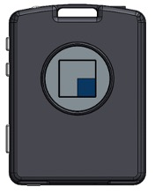
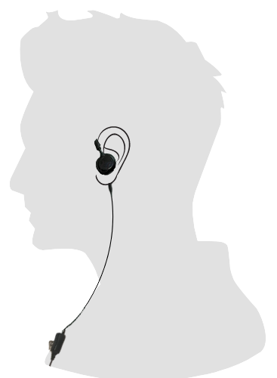


Stay Connected with Your Team!
Start of Shift:
Always choose the Communicator with the BLINKING PURPLE LIGHT.
End of Shift:
Return your Communicator to the charging rack.
Insert Communicator Facing This Way
Follow the arrows to ensure it is facing the right direction.
Clip your Headset:
Headset microphone should be about 5 inches from your mouth.
Be Ready:
Have your headset on when you pair your Communicator.
Play Your Messages:
Give the command, "Play Messages" so you can hear your personal messages.
Clip the mic to your shirt 5” from your mouth
Theatro Hardware Best Practice Reminders
Return / Sick Box? - Ensure there is a designated location to place Communicators that need to be sent back to Theatro.
Non-Functioning Device? - Remove from the Charging Rack & Place in the Return Box
Broken Button?
Solid Red LED?
Loose Audio Jack?
Poor Battery Performance?
Missing Label?
Cracked Case?
Use Prepaid Fed-Ex Label & Return to Theatro
Non-Functioning Charging Rack? - Call Theatro Support & Get a Replacement, No Questions Asked!
Missing Devices? - Remind team members to always bring back their Communicator at the end of the shift.
Restock Alert? - Reminder…Theatro monitors the hardware level and will auto restock devices based on the need in your store
Got Questions……..We're Here to Help
Theatro’s Support Team is here for YOU!
Say “Message Tech Support” & Theatro will solve your problem!
Say “Message Tech Support” from the Communicator, email support@theatro.com or call 844-843-2876
Hardware Questions
Providing shipping labels
Correcting name pronunciation
Modifying or changing a name
Theatro Best Practices Guide Revision 1.0 – 12/27/2024

